Slide 1
Payable lease and SBITA FISCAL YEAR-END ADJUSTMENT TRAINING March 26, 2025
State Financial Services

Slide 2
Presenter
Catherine Koch, Accountant, Statewide Accounting Bureau

Slide 3
Agenda
Background
Purpose of Training
FYE Adjustments
Resources

Slide 4
Background
The State of Montana implemented GASB 87 Leases and GASB 96 SBITA a few years ago
Due to the complexity of implementing new standards, the Statewide Accounting Bureau has recorded the fiscal year-end adjustments for all agencies
Lease journal entries for the lease liability side are similar to other long-term debt FYE journal entries (modified accrual fund entry, interest adjustment, and principal reduction)
Lease payment cost allocations and associated lease interest adjustment

Slide 5
Purpose of Training
How to prepare and record the three FYE lease adjustments (as applicable) step-by-step

Slide 6
FYE Journal Entries
Introduce new lease queries
MTLA_LEASE_DETAILS_BU (existing)
MTLA_LEASE_MODIFIED_ENTRY (new for FYE JE)
MTLA_LEASE_FYE_INTEREST_BU (new for FYE JE)
MTLA_LEASE_FYE_CVSNC_BU (new for FYE JE)
MTLA_LEASE_PRINCIPAL_BU (new)
MTLA_LEASE_PAYABLE_BAL_BU (new)

Slide 7
FYE Journal Entry – Modified Accrual Entry
For Governmental Funds only
In both ACTUALS ledger and ENTITYWIDE ledger
One time only in the year the lease commenced – can be recorded after the lease is activated or FYE
MTLA_LEASE_MODIFIED_ENTRY
63410/583300 for lease and 63409/583301 for SBITA
Ledger | Fund | Account | Account Description | Debit | Credit
ACTUALS | 0xxxx | 63410 | NB Lease Commence Gov Fund | 1,563,480.17
ACTUALS | 0xxxx | 583300 | Inception of Lease-NONBUDGETED |  | 1,563,480.17
Ledger | Fund | Account | Account Description | Debit | Credit
ENTITYWIDE | 0xxxx | 583300 | Inception of Lease-NONBUDGETED | 1,563,480.17
ENTITYWIDE | 0xxxx | 63410 | NB Lease Commence Gov Fund |  | 1,563,480.17

Slide 9
FYE Journal Entry – Interest Adjustment
All funds that have lease payments allocated must show the corresponding interests
MTLA_LEASE_FYE_INTEREST_BU
In the Actuals Ledger only
69503/69502 for lease and 69603/69602 for SBITA
Q: what if lease cost allocations between governmental fund and proprietary fund changed?
A: you need to amend the split lease for the G and P first
Q: what if the lease cost allocations do not match the scheduled lease payment amounts for proprietary funds?
A: you may need to amend the lease first to correct the allocation in the LA module
Ledger | Fund | Account | Account Description | Debit | Credit
ACTUALS | 0xxxx | 69503 | ROU NB Lease Interest | 113,631.96
ACTUALS | 0xxxx | 69502 | NB ROU Lease Principal |  | 113,631.96

Slide 10
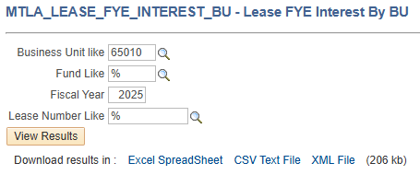
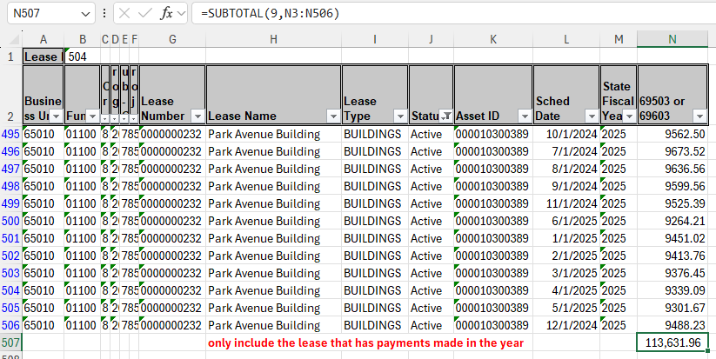
Example for Single Lease – One Building Lease

Slide 11
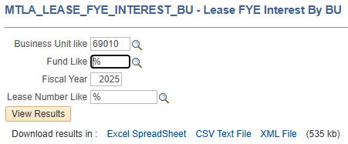
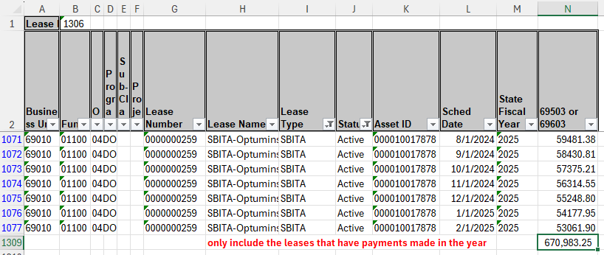
Example for Multiple Leases – Five SBITAs

Slide 12
FYE Journal Entry – Current Lease Payable Adjustment
Funds that have a lease payable balance at FYE
MTLA_LEASE_FYE_CVSNC_BU
Ledgers depending on the fund category (ENTITYWIDE ledger for governmental fund or ACTUALS ledger for proprietary fund)
2124B/2104B for lease and 2124F/2104F for SBITA
This journal entry must be reversed on 7/1
Fund | Account | Account Description | Debit | Credit
0xxxx | 2104B | Standard Lease | 356,129.53
0xxxx | 2124B | Standard Lease - Due W/in 1 Yr |  | 356,129.53

Slide 13
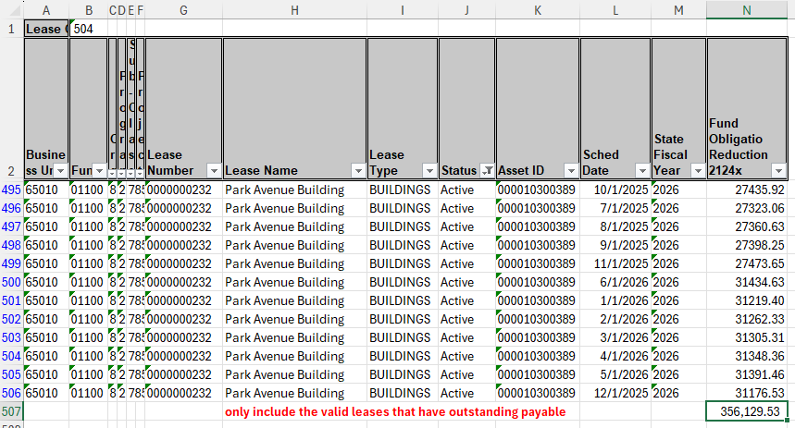
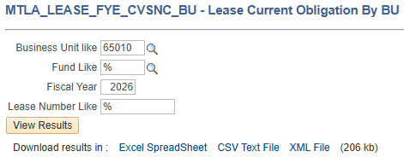
Calculate the current portion for this reporting year

Slide 14
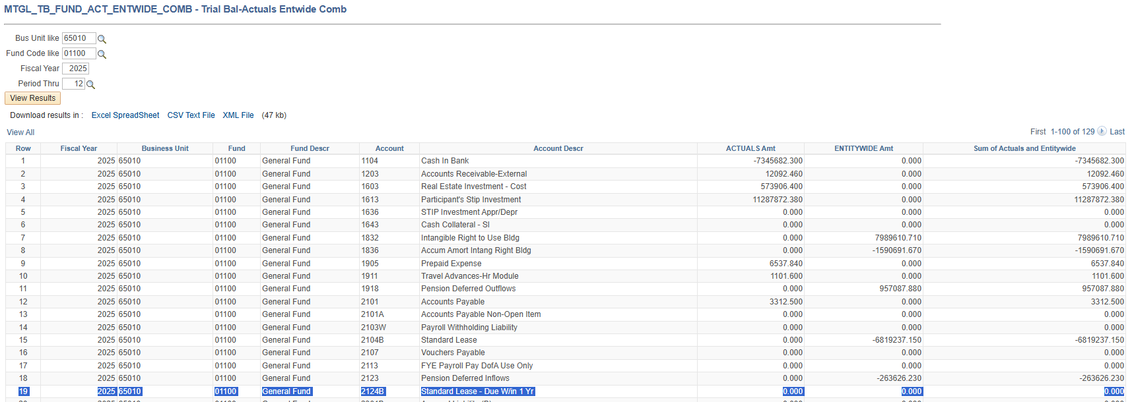
Make sure the beginning balance in the current portion account is $0; otherwise, reverse the balance before recording the current portion for this reporting year

Slide 15
Resources
https://sfsd.mt.gov/SAB/AgencyResources/Agencyindex
This training video
The training slides in MS PowerPoint
The Word File illustrates the lifecycle of an example lease
Governmental fund lease interest allocation example
MOM-SFSD-POL-SAB 336-Accounting for Leases as a Lessee
MOM-SFSD-POL-SAB 338-Subscription-Based IT Arrangements (SBITA)
Other lease resources
Questions & Cases https://montana.servicenowservices.com/sp

